Slide 1
School City Basics
Notes:
http://tinyurl.com/TUHSD-Signin-913

Slide 2
TUHSD is committed to developing the potential of all students, staff, and community.
Our TUHSD Mission

Slide 3
Our TUHSD Vision: Learning today, leading tomorrow.
TUHSD Strategic Areas
College, Career and Life-Ready Students
Communication and Partnerships
Creating a Highly Effective Work Force
Do iT with PRIDE

Slide 4
Our TUHSD Vision: Learning today, leading tomorrow.
Foundational Beliefs
All decisions are student centered
All TUHSD learners are globally prepared and competitive
Guaranteed and viable curriculum, instruction and assessment
We are committed to improving the TUHSD community
Do iT with PRIDE

Slide 5
Our TUHSD Vision: Learning today, leading tomorrow.
Three Interconnected Practices
High functioning PLCs that use data and support student achievement
Guaranteed viable curriculum, instruction and assessment
Staff and student support and training
Do iT with PRIDE

Slide 6
Management
Every classroom has a greeting before students enter the room
Clearly stated rules are posted and followed
Specific plans for technology for learning are communicated and followed
Every student has a caring adult who connects with them each period

Slide 7
Instruction
Lesson plans are prepared for each lesson taught with Elements of Instruction in mind
Each lesson has the State Standards posted and the learning objective communicated
Execution of lesson shows students’ visible authentic engagement in the lesson

Slide 8
Essential Questions
How is a test made on SchoolCity?
How is a report run on SchoolCity?
Do iT with PRIDE

Slide 9
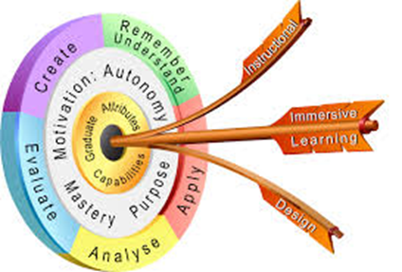
Learning Objectives
Make an Answer Key Only (AKO) Test Using SchoolCity.
Make a test on SchoolCity using Inspect Test Bank.
Upload an ExamView Test into SchoolCity
Run reports in SchoolCity
Do iT with PRIDE

Slide 10
Login to SchoolCity
Do iT with PRIDE

Slide 11
Login to SchoolCity
Do iT with PRIDE

Slide 12
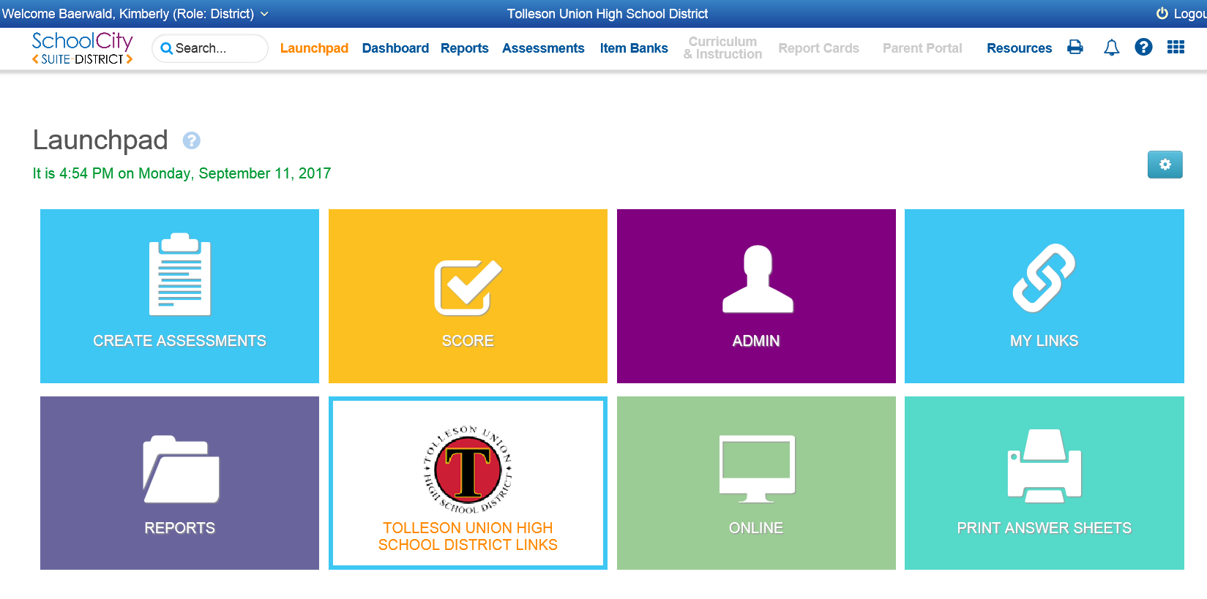
Creating and Assessment
Do iT with PRIDE

Slide 13
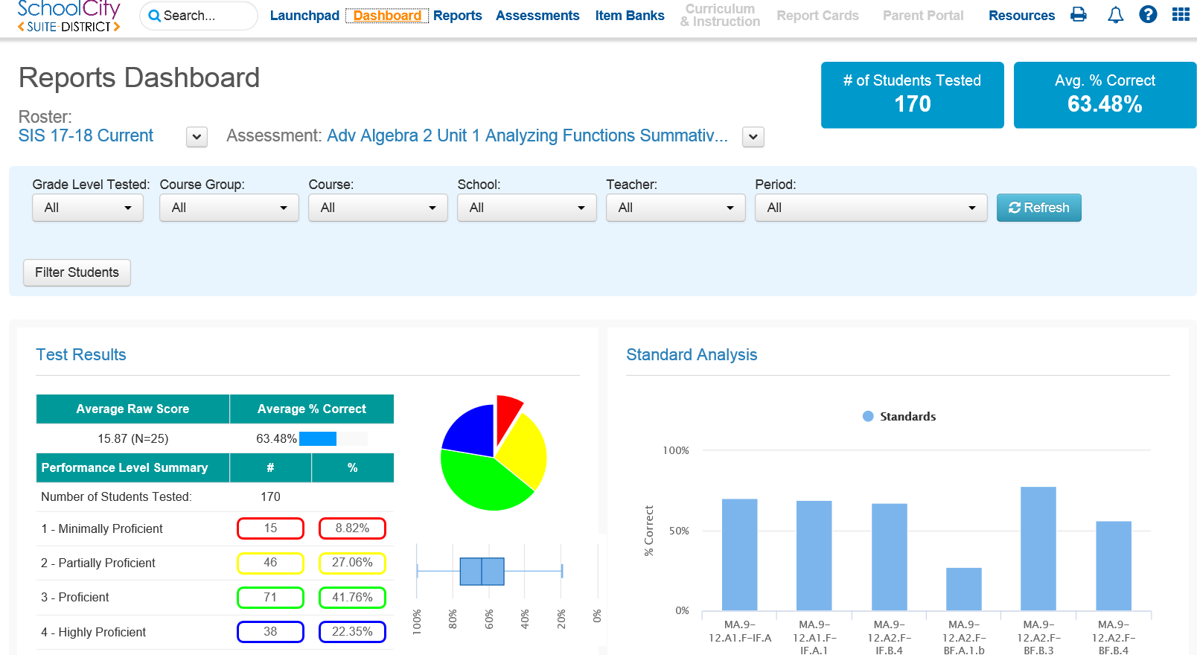
Dashboard
Do iT with PRIDE

Slide 14
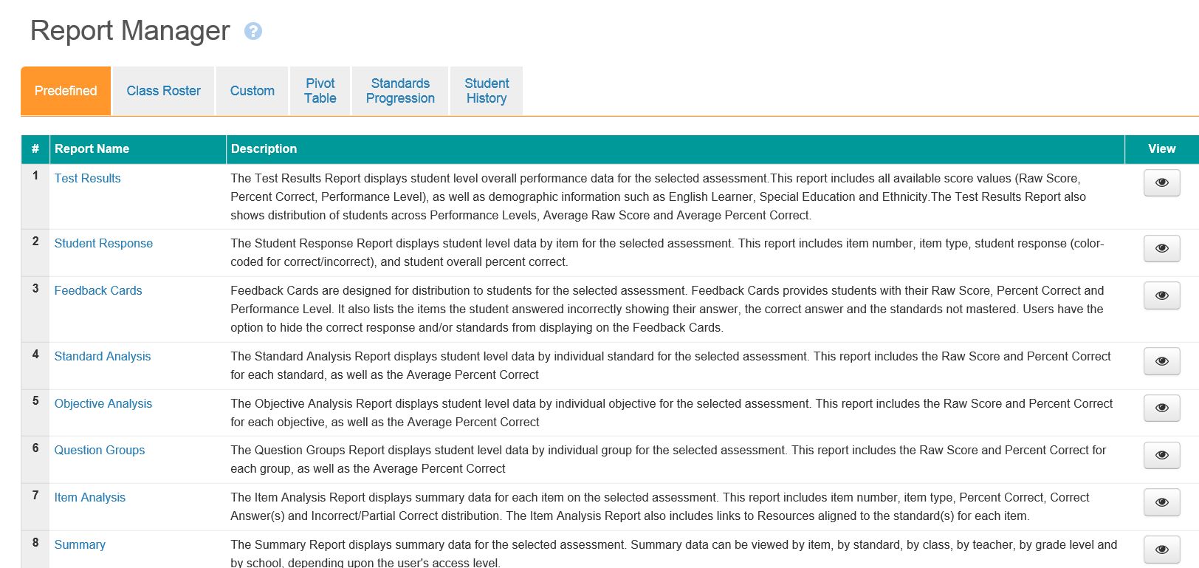
Running a Report
Do iT with PRIDE

Slide 15
Survey
http://tinyurl.com/TUHSDPD9-13

